Slide 1
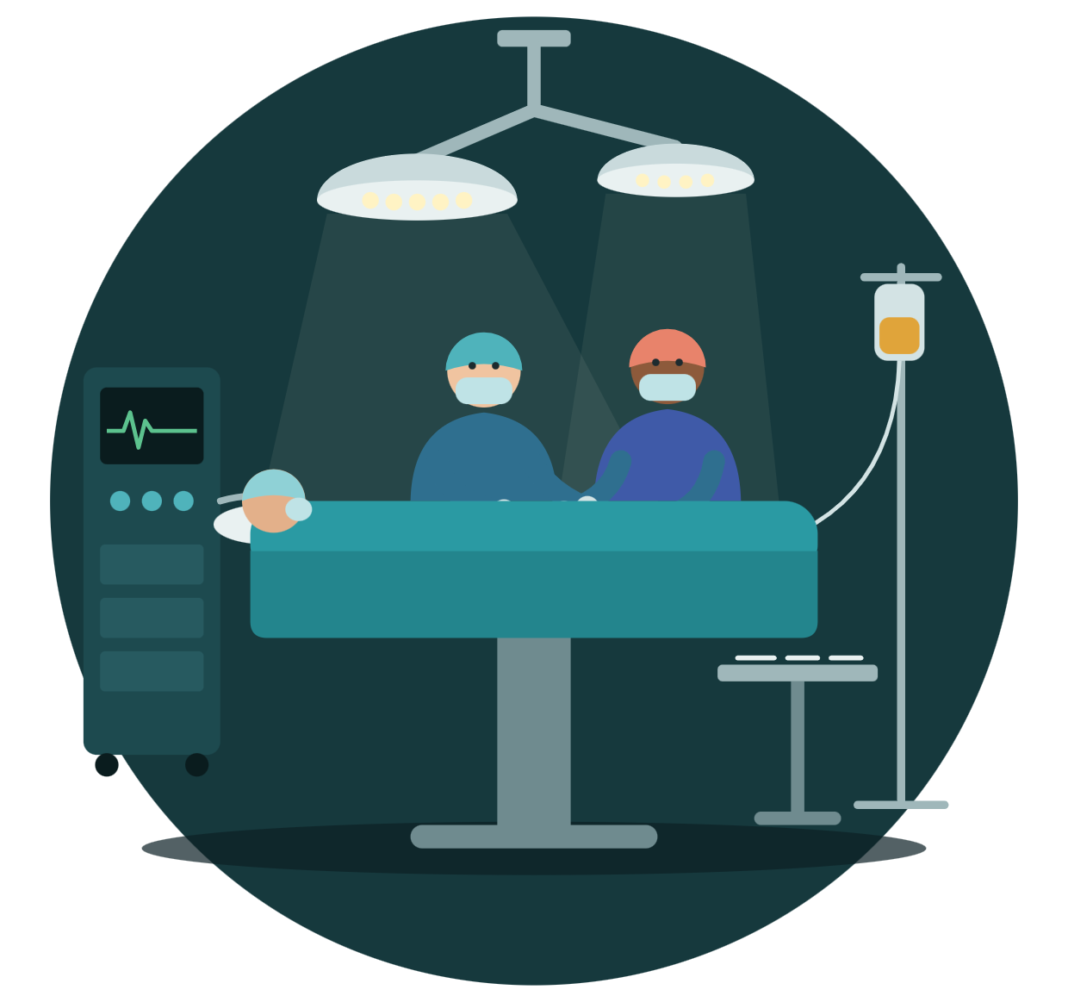
Pre-Op Readiness
CAI 5724 · AI DESIGN PROJECT · NOVEMBER 4
An AI assistant that reads a surgical patient’s chart and tells the nurse and the anesthesiologist what still needs to happen before surgery
Mombo Ngu · Nikolas Platon · Willie Robinson · April Walter
Notes:
[Presenter: ____] About 20 seconds. Hi everyone, we’re [names]. Our project is a pre-op readiness assistant. One-line pitch: before a patient goes into surgery, a lot of small things have to be in place: labs, consents, clearances, blood, medication instructions. Our prototype reads the patient’s chart and tells the pre-op nurse and the anesthesiologist, each from their own point of view, whether the patient is ready and what to do next. Plan for our 15 minutes: about 5 minutes on the problem and how the system works, then about 8 minutes where every one of you gets your own fictional patient to work through, then a short discussion and questions. Get your phones or laptops ready. You’ll need them in a few minutes.

Slide 2



Surgery stalls when a pre-op item is missing
THE PROBLEM
Scattered
Manual
Hidden
Labs, consents, clearances, blood bank, medication instructions and the H&P live in different parts of the chart.
The pre-op nurse and the anesthesiologist each check it by hand for every surgical patient.
Some problems are only in the free-text H&P, like new chest pain or a blood thinner the patient never stopped.
Gaps found late mean delays, cancellations, idle ORs and overtime. The gap is speed and specificity.
Notes:
[Presenter: ____] About 50 seconds. Before any surgery, a checklist of things has to be in place: the right labs drawn and in range, consents signed for surgery, anesthesia and blood, clearances from cardiology or pulmonary when needed, blood ready in the blood bank, and instructions about medications like blood thinners and insulin. Three things make this hard. Scattered: all of that lives in different places in the chart. Manual: the pre-op nurse and the anesthesiologist each go through it by hand, for every surgical patient. Hidden: some problems never show up as a field you can check. They’re written in the history and physical, the H&P note. For example, a patient who mentions new chest pressure, or says they’re still taking a blood thinner they were told to stop. When these gaps surface late, the effects ripple out, as we wrote in Milestone 1. Patients face delayed or cancelled surgery and more anxiety. OR teams scramble to recover lost time, rooms that were opened get reallocated, and staff waiting on a shifting schedule end up on overtime. Surgeons and anesthesiologists left idle try to backfill with other patients who may not be ready either. Our EHRs already display and summarize the data. What’s missing is speed and specificity: something that reviews it all fast enough, and turns it into next steps for each role, before the problem reaches the OR. [Optional, from our team: April is an RN and Epic analyst, so she can add one quick real-world example here.]

Slide 3


Two users, two different questions
WHO IT’S FOR
Pre-op nurse
Anesthesiologist
“What still has to happen before this patient goes back?”
“Is this patient safe for anesthesia, and should we proceed?”
Consents and paperwork
Labs to draw, results to chase
Day-of checks: blood thinners, insulin, CPAP
OR safety set-up: latex, malignant hyperthermia
Cardiac and pulmonary risk
Abnormal potassium, INR, hemoglobin, glucose
Anticoagulation and blood availability
Airway and prior anesthesia problems
Milestone 2: we narrowed the scope from every perioperative role to these two.
Notes:
[Presenter: ____] About 40 seconds. In Milestone 2 we narrowed our scope to two users, because they look at the same chart but ask very different questions. The pre-op nurse asks: what still has to happen before this patient goes back? Consents, labs to draw and results to chase, day-of checks like confirming the blood thinner was held or the CPAP came with the patient, and safety set-up like a latex-free room. The anesthesiologist asks: is this patient safe for anesthesia, and should we go ahead? Heart and lung risk, abnormal labs like a high potassium or INR, bleeding risk and blood availability, and airway or past anesthesia problems. So our system gives each of them their own summary and their own list of next steps from the same chart.

Slide 4
From sketch to class-ready prototype
HOW WE GOT HERE
Sep 9 · Milestone 1
Sep 30 · Milestone 2
Oct 9 · Milestone 3
Oct 17 · Build
Oct 28 · Check-in
Problem and AI sketch
Architecture
Roadmap
First prototype
Class-ready
Two users. A tab inside the EHR chart. Flags what’s missing; the user accepts or declines.
After instructor feedback: surgery lookup became a database query, and scanned-document QA became text QA.
Synthetic dataset v2 with real lab values, a rules baseline, and an OR schedule after 8 design rounds.
Timeline compressed for Nov 4. Each student gets their own patient; schedule rules refined.
Gaps surface too late. Vision: a role-specific readiness review with next steps.
Notes:
[Presenter: ____] About 45 seconds. Quick look at how our milestones shaped what you’re about to use. Milestone 1: we described patients arriving unprepared because gaps surface too late, and sketched a tool that gives each role a quick readiness review with next steps, instead of just reporting what data exists. Milestone 2, the architecture: we narrowed to two users, decided the tool should live as a tab inside the patient’s EHR chart, and that it should flag what’s missing and let the user accept or decline each next step. Milestone 3, the roadmap: our instructor’s feedback changed the design. Finding the scheduled surgery became a plain database lookup instead of an AI task, and reading scanned documents became question answering over text. We also planned a synthetic data layer. October 17, the first build: we built our own dataset with real lab values, a rules-only baseline to compare against, and an OR schedule that took eight rounds of feedback to get right. Check-in: our presentation date moved earlier, so we compressed the timeline. And since the check-in, we made it work for a whole class at once: each of you will get your own patient in a minute.

Slide 5


Four modules, then a person decides
HOW IT WORKS
1 · Lookup, no AI
2 · LLM
3 · LLM
4 · LLM
Human review
Find the surgery
Answer questions
Summarize by role
Suggest next steps
Accept or decline
Pulls the scheduled case and what this procedure requires
11 readiness questions about the chart, each answer citing its record
A nurse view and an anesthesiologist view of the same chart
Compares the chart to our criteria and picks from the role’s order set
Every step, with a reason when declined
Readiness also drives the OR schedule: rules suggest a reschedule, a later time, or the first case of the day. Suggestions only.
Notes:
[Presenter: ____] About 1 minute. Here’s what happens when a chart is opened. These are the four modules from our Milestone 3 roadmap. Module 1 finds the scheduled surgery and pulls the requirements for that procedure. After our instructor’s feedback, this is a plain database lookup. No AI needed. Modules 2 to 4 use a large language model with context engineering: we don’t train a model, we give it carefully built prompts with the chart and our criteria. Module 2 answers 11 fixed readiness questions about the chart, and every answer has to cite the record it came from. Module 3 writes a summary for the specific role, nurse or anesthesiologist. Module 4 compares the chart to our hospital criteria and picks next steps, but only from that role’s order set, a fixed list of actions. That keeps it from inventing orders and lets us grade it. Then a person accepts or declines every step. Accepting doesn’t mark something done: it stays open until the chart shows it. On top of that, the readiness results drive suggestions on the OR schedule. Those are rules, not the LLM, and the schedule never changes itself.

Slide 6
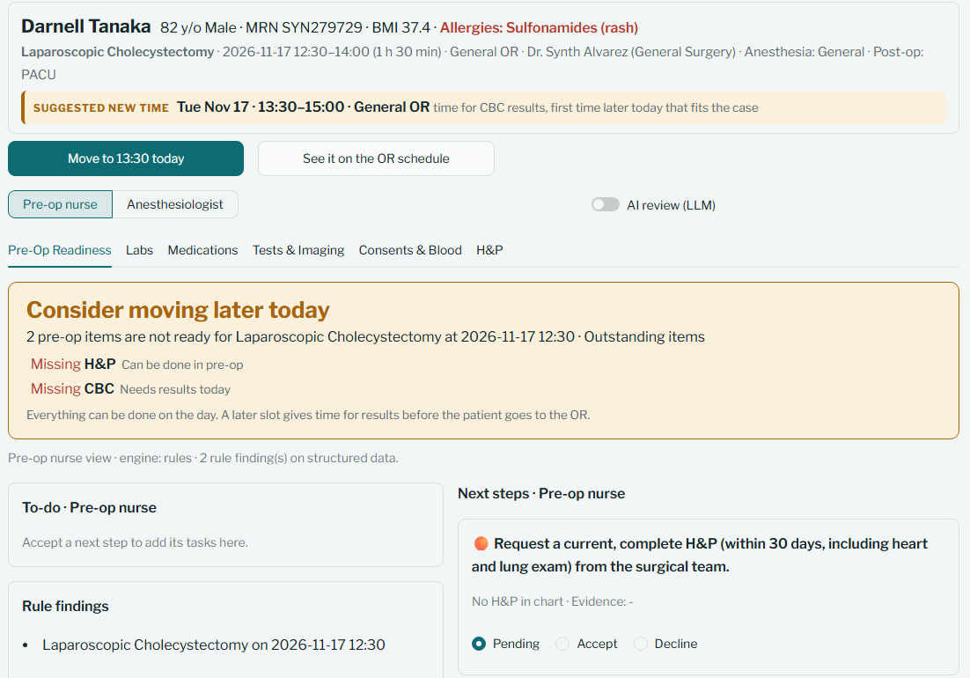
What the pre-op nurse sees
THE PROTOTYPE
1
Suggested new time
Right in the chart header, with one button to apply it.
1
2
Readiness card
What isn’t ready, and whether it’s done in pre-op, needs results today, or takes days.
2
3
Next steps by role
Each with its reason and evidence. Accept or decline every one.
3
Notes:
[Presenter: ____] About 30 seconds. This is the real app, the pre-op readiness tab, from the nurse’s point of view. This patient is scheduled for a gallbladder removal at 12:30. 1. At the top, in the chart header: a suggested new time, 13:30, with one button to apply it. 2. The readiness card says why: two items aren’t ready. The H&P can be done in pre-op, but the CBC needs a lab result today, so a slightly later slot gives time for it. 3. On the right, the nurse’s next steps, each with its reason and evidence, and Accept or Decline on every one. You’ll each have one of these in front of you in a couple of minutes.

Slide 7
Some problems only live in the H&P
WHY AI
Rules can check
Only reading the note finds
Missing or expired labs
Abnormal values, like potassium 5.9
Unsigned consents
Missing clearances
New chest pressure at rest
An allergy missing from the allergy list
Family history suggesting malignant hyperthermia
A blood thinner the patient never stopped
An H&P with no heart or lung exam
Guardrails: picks only from the role’s order set · cites a chart record for every answer · never fills in missing values · a person decides
Notes:
[Presenter: ____] About 45 seconds. So why use AI at all? In Milestone 1 we pointed out that today’s EHR tools mostly apply static rules: if X is missing, flag Y. A rules checker like that can already catch a lot: missing or expired labs, a potassium of 5.9, an unsigned consent, a missing clearance. We built exactly that as our baseline, so we could measure what the AI adds. But some problems only exist as words in the H&P note. A patient describing new chest pressure at rest. An allergy written in the note that isn’t on the allergy list. A family history that suggests malignant hyperthermia. A patient who says they’re still taking a blood thinner the medication list says to hold. Or an H&P that’s missing the heart and lung exam entirely. A rules engine can’t read those. A language model can. That’s the gap the AI is for. And because this is healthcare, we built in guardrails: it can only pick actions from the role’s order set, every answer has to cite a record in the chart, the prompts tell it never to invent values, and a person makes every decision.

Slide 8
We built our own synthetic patients
OUR DATA
100
5
80/20
80
fictional patients
procedures, 20 each
dev / held-out test
with 1–4 planted problems
Why synthetic
How it’s built
No public dataset had consents, clearances, blood bank, flagged labs and H&P notes together, with known answers.
A seeded Python generator plants problems, some only in the H&P. The answer key is never shown to the AI.
Notes:
[Presenter: ____] About 30 seconds. This was a stage we added to our roadmap. Our Milestone 3 plan used MIMIC-IV, but no public dataset had everything pre-op review needs in one place: consents, clearances, blood bank status, flagged lab values, and H&P notes, plus known right answers to grade against. So we built our own: surgical_patient_dataset_v2. 100 fictional patients, 20 for each of five procedures: gallbladder removal, mastectomy, knee arthroscopy, ureteroscopy and coronary bypass. 80 cases for development, 20 held back for testing. 20 patients are clean, and the other 80 have one to four planted problems, some of them written only into the H&P. It’s generated by a Python script with a fixed seed, so it comes out the same every time. The answer key sits in its own folder and is never given to the AI, and a test checks that. And because it’s synthetic, there’s no patient privacy risk.

Slide 9
Rules alone miss every note-only problem
RESULTS SO FAR
Engine · role | Precision | Recall | F1 | Note-only recall | Status correct
Rules · nurse | 1.00 | 0.82 | 0.90 | 0 of 5 | 18 of 20
Rules · anesthesiologist | 1.00 | 0.83 | 0.91 | 0 of 3 | 18 of 20
AI · nurse | [__] | [__] | [__] | [_ of 5] | [_ of 20]
AI · anesthesiologist | [__] | [__] | [__] | [_ of 3] | [_ of 20]
Rules are perfect on structured fields by design. Catching what’s only in the note is the AI’s job.
20 held-out test cases. The answer key comes from our own teaching rules, so scores show whether the system applies them, not whether they are clinically right.
Notes:
[Presenter: ____] About 45 seconds. We score each role separately against the answer key on the 20 held-out test cases. Precision: of the steps it suggested, how many were right. Recall: of the steps it should have suggested, how many it found. Note-only recall: the problems you can only find by reading the H&P. The rules baseline gets precision 1.00 and recall around 0.82 for both roles, and the right overall status in 18 of 20 cases. That’s expected: the answer key was built from the same rules. But look at note-only recall: zero of five for the nurse, zero of three for anesthesia. It catches none of the problems that only show up in the note. [If you have the AI run: The AI pipeline got ___ precision and ___ recall, and caught ___ of 5 and ___ of 3 note-only problems.] [If not: We’re running the AI on the held-out set next. The question is whether it matches the rules on structured data and closes that note-only gap.] Honest caveat: our answer key comes from our own teaching rules, so this measures whether the system applies our rules, not whether the rules are clinically right. And 20 cases is a small sample.

Slide 10
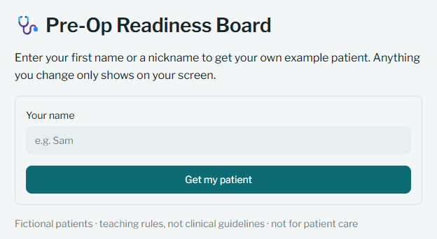
Your turn: review your own patient
HANDS-ON · ABOUT 8 MINUTES
[app link]
Enter your first name and you get your own fictional patient, marked with a star. Nothing you change affects anyone else.
This is the first screen you’ll see
Notes:
[Presenter: ____] About 30 seconds, then leave this up while people join. Now it’s your turn. Open this link on your phone or laptop. [Read the link out loud, or put it in the class chat.] This is the first screen you’ll see. Enter your first name or a nickname, and the app gives you your own fictional patient, marked with a star. Each of you gets a different patient, and anything you click only changes your own screen, so you can’t break anything for anyone else. Give it a moment to load. Raise your hand if you don’t see a patient. [Team: someone watch the Project team panel in the sidebar to see how many people have signed in. Before class, reset the demo so the first student gets the first patient.]

Slide 11
Five things to try
HANDS-ON
1
Open your starred patient. Are they ready for surgery?
Read the card at the top of the Pre-Op Readiness tab.
2
Switch between Pre-op nurse and Anesthesiologist
What does each one need to do? What’s the same?
3
Open the H&P tab and read the note
Is there anything in it the checklist didn’t flag? That’s the gap our AI is for.
4
Accept or decline each next step
Declining asks for a reason. Accepted steps add tasks to your to-do list.
5
Apply a suggested time, then open the OR schedule
See where your patient moved, and who else moved with them.
Notes:
[Presenters: all] About 5 and a half minutes of working time. Walk around and help. Here are five things to try. A shorter version is in the app under "What to try". 1. Open your starred patient and read the card at the top. Green means ready. Amber or red means something isn’t ready, and it tells you what. 2. Switch between the pre-op nurse and the anesthesiologist. Same patient, different jobs. Notice what changes. 3. Open the H&P tab and read the note. Look for anything the checklist didn’t flag, like a new symptom, an allergy that isn’t on the allergy list, or a blood thinner the patient says they’re still taking. Not every patient has one. Problems like these only show up by reading the note, and that’s exactly what the AI part of our system is for. 4. Accept or decline each next step. If you decline, it asks why. Accepted steps go to your to-do list, and they stay open until the chart shows they’re done. 5. If your patient has a suggested new time, apply it, then open the OR schedule and find them. Sometimes other patients move too. [At about 4 minutes, switch to the next slide so people can see why cases move. At 5:30, call time and go to discussion.] [If someone turns on the "AI review" toggle, the app just keeps showing the rules-only check, because the AI isn’t turned on for the class. Nothing breaks.]

Slide 12
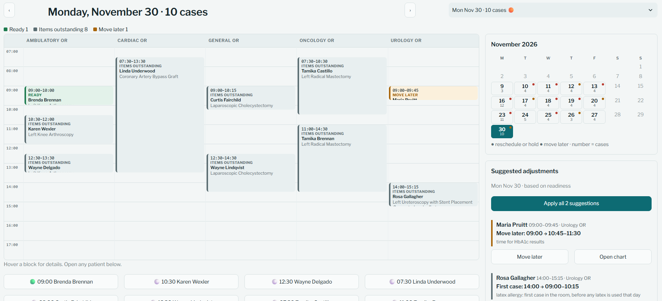




Why a case moves, or doesn’t
ON THE OR SCHEDULE
Missing consent, H&P or EKG
Stays put · done in pre-op
One missing lab
About an hour later · time for results
Clearance, PFT or echo
Rescheduled · usually takes days
Nov 30: a latex-allergy patient is suggested as the first case in Urology, and the case before them moves later.
Latex allergy
First case in the room that day
Suggestions only: staff confirm with the surgeon, anesthesia and the patient. Teaching rules, not hospital policy.
Notes:
[Presenter: ____] Put this up around minute 4 of the activity, while people keep working. If you’re wondering why your patient moved, or didn’t, here are the schedule rules. A missing consent, H&P or EKG doesn’t move the case. Those get done in pre-op before the patient goes back. One missing lab moves the case about an hour later, enough time to draw it and get the result. Anything that takes days, like a cardiology or pulmonary clearance, a PFT or an echo, means a new date. And a latex allergy means the patient should be the first case in that room, before any latex has been used that day. On the right is a real day from our schedule, November 30. Rosa Gallagher has a latex allergy and was booked at 2 PM, so the app suggests making her the first case in the Urology OR, and the patient who was first moves a little later. "Apply all" makes both changes at once. Our team set these rules, and they’re teaching rules, not hospital policy. The schedule only suggests: staff still confirm with the surgeon, anesthesia and the patient.

Slide 13
What did you notice?
DISCUSSION
1
What did you find in the note that the checklist didn’t flag? Would you want an AI to catch that?
2
Which suggestion did you decline, and why?
3
What would need to be true before a hospital used this?
Notes:
[Presenter: ____] About 1 and a half minutes. Ask one or two of these, depending on time. 1. What did you find in the note that the checklist didn’t flag? Would you want an AI to catch that? Ask who found something in the H&P. Connect it back: that’s exactly what our AI modules read for, and the rules baseline caught none of those problems in testing. Follow-up: what would make you trust an AI to flag it? (Answer if it comes up: every AI suggestion has to cite the chart record, so you can check it, and a person still decides.) 2. Which suggestion did you decline, and why? This is the human-in-the-loop part. The decline reasons are saved, and in a real system they could show where the suggestions are wrong. 3. What would need to be true before a hospital used this? Good answers to draw out: tested on real records, rules reviewed by clinicians, built into the EHR, privacy and security, clear responsibility when it’s wrong. If nobody answers, share one you saw: [e.g., "One of us declined a lab because it was done at an outside clinic"].

Slide 14
What this prototype can’t tell us yet
LIMITATIONS AND NEXT STEPS
Limitations
Next steps
Fictional patients and teaching rules, not clinical guidelines
The answer key uses the same rules the AI is given
Only 20 held-out test cases
The AI can be wrong, so a person reviews every step
Each AI review costs money
[Score the AI on the held-out test set]
Have nurses and anesthesiologists review the rules
Test on real de-identified records, like MIMIC-IV
Run inside the EHR and update as results arrive
Learn from accept and decline reasons
Notes:
[Presenter: ____] About 45 seconds. To be honest about what this can and can’t show: The patients are fictional, and our criteria are teaching rules we wrote, not clinical guidelines. Our answer key comes from the same rules the AI is given, so a high score means it applies our rules well, not that the rules are clinically right. 20 test cases is small: one or two misses move the numbers a lot. The AI can be wrong, which is why every suggestion goes through a person. And each AI review is a paid API call, which matters at hospital scale. Next steps: [score the AI on the held-out test set, if not done yet]. Have practicing nurses and anesthesiologists review the rules and wording. Try it on real de-identified records like MIMIC-IV, where the data rules allow it. Our Milestone 2 vision was a tab inside the EHR that updates itself as new results come in, so that’s the real form factor. And the accept and decline reasons we collect could show where the suggestions need to improve.

Slide 15
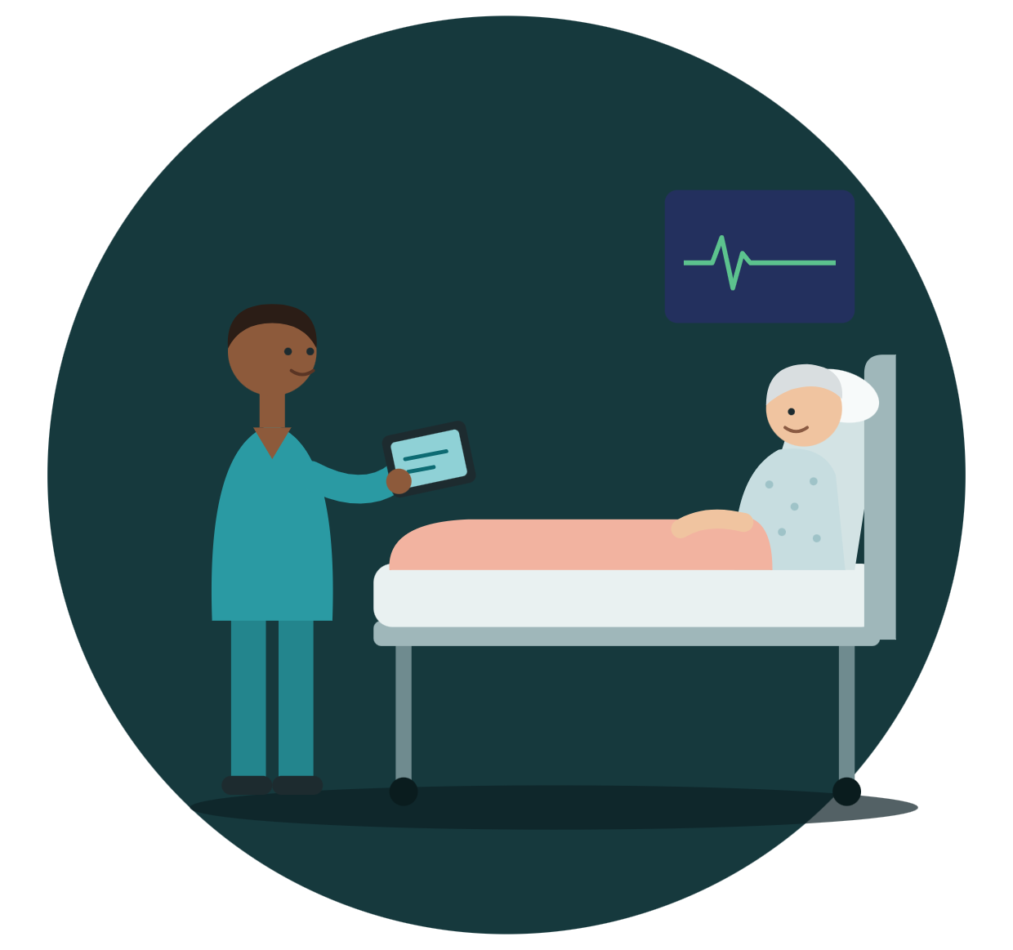
Thank you.
Questions?
PRE-OP READINESS
github.com/nplat15/Surgical-Patient-Preparedness-Project
Mombo Ngu · Nikolas Platon · Willie Robinson · April Walter
Notes:
[Presenter: ____] Remaining time, about 1 minute. Thank you! The code, the dataset generator and the app are all in our GitHub repo, and the app link stays up after class if you want to keep exploring. Happy to take questions. Likely questions and short answers: Why not train your own model? We didn’t have labeled real pre-op data, and context engineering with an existing LLM let us plug in our criteria and each role’s order set directly. How do you stop it from making things up? It picks only from a fixed order set, cites a chart record for every answer, is told never to fill in missing values, and a person decides. Why synthetic data? No public dataset had consents, clearances, blood bank and H&P notes with known answers, and there’s no privacy risk. Would this replace the nurse? No. It does the chart search, and the nurse and anesthesiologist make every decision. What about cost? Each new patient and role is three API calls. Results are cached, so repeats are free.

